Slide 1


Neutron activation analysis for life sciences
Marie Freibergová, Filip Randák, Jana Šošková
Czech Technical University in Prague
Faculty of Nuclear Sciences and Physical Engineering
Supervisors: Marina V. Frontasyeva, Wael Badawy
Joint Institute for Nuclear Research
Frank Laboratory of Neutron Physics

Slide 2
Neutron Activation Analysis
Neutron activation analysis is an isotope specific analytical technique for the qualitative and quantitative determination of elemental content.
P. Bode, J. J. M. de Goeij, ‘Activation Analysis’, Encyclopedia of Environmental Analysis and Remediation, J. Wiley & Sons, New York, 1998, ISBN 0-471-11708-0, pp 68–84.
Nondestructive Destructive

Slide 3
Primary Method
A primary method of measurement is a method having the highest metrological properties, whose operation can be completely described and understood, for which a complete uncertainty statement can be written down in terms of SI units.
Since 2007
Another Primary methods
  Isotope dilution mass spectrometry
  Coulometry
  Gravimetry
  Titrimetry
  Determination of Freezing Point Depression

Slide 4
NAA + AAS

Slide 5
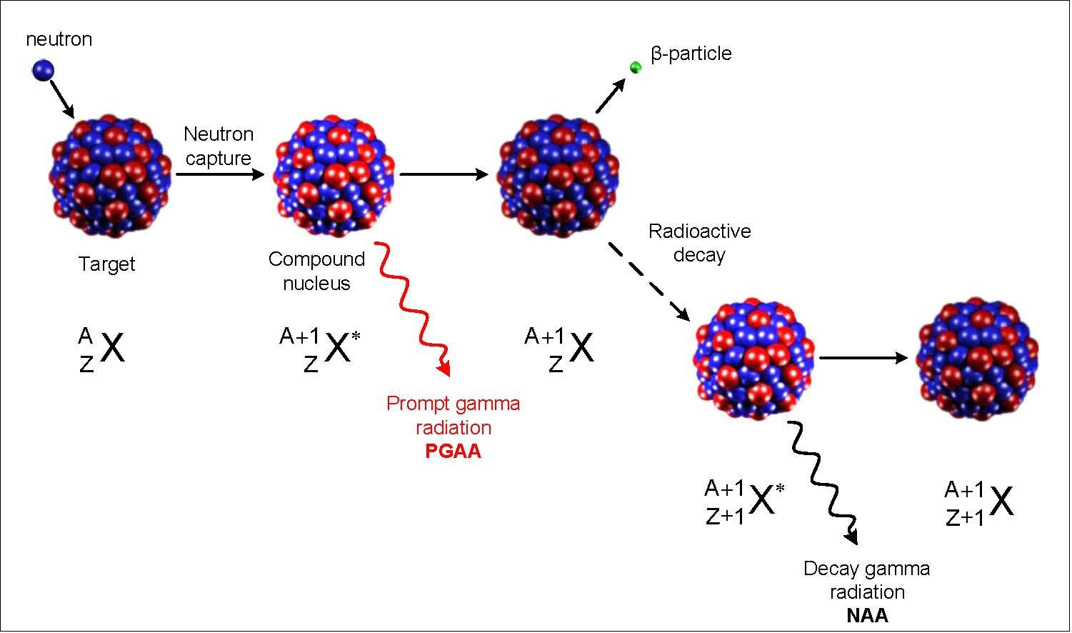

Sources:
  Reactors
  Generators
  Radionuclides
Reaction (n;$γ$)

Slide 6
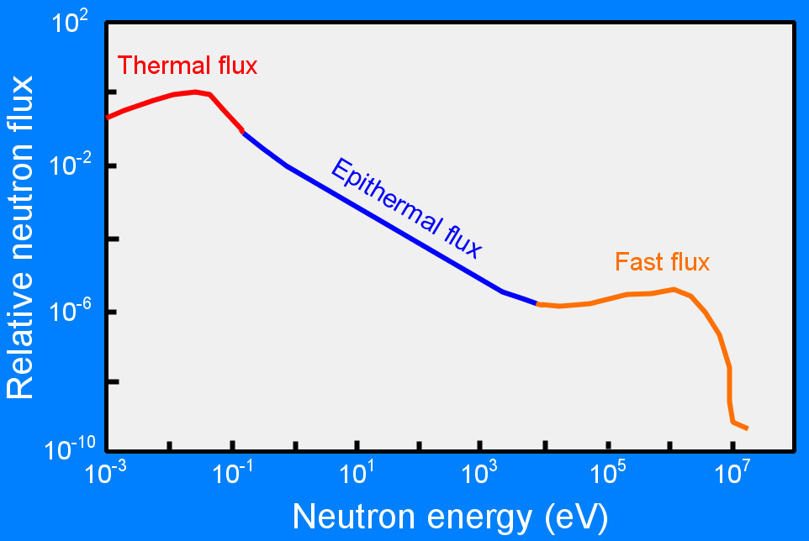
Neutrons
Thermal 0.025eV – 0.5eV
Epithermal 0.5eV – 100keV
Fast < 100keV

Slide 7
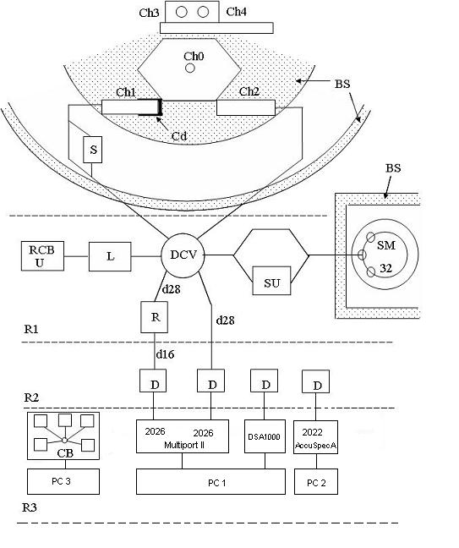
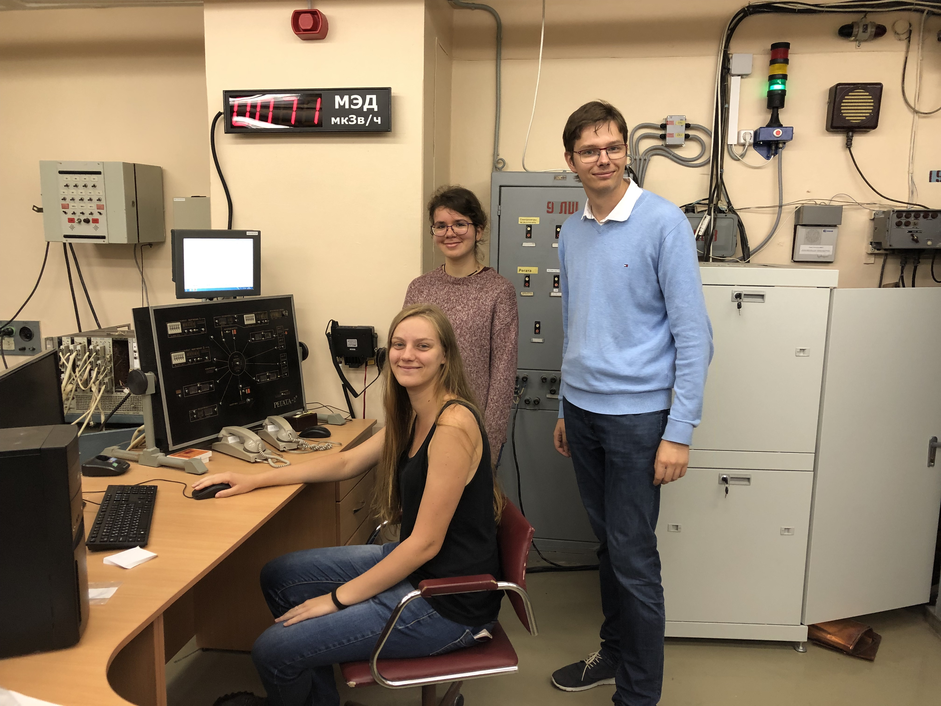
Irradiation channels
Storage magazine
Intermediate storage
Directional control valves
Loading unit
Separate unit
Radiochemical glove-cell
Repacking unit
Detector
Rooms where the system is located
Control board

Slide 8
Life Sciences
Biomonitoring
UNECE ICP Vegetation
Antro-pology
Food products
Medicinal plants
Bio-nano-
technology
Cosmos
Geology
Environment

Slide 9
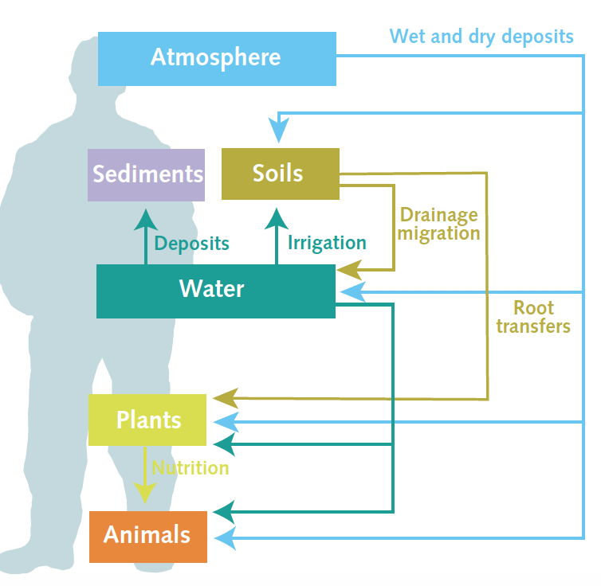
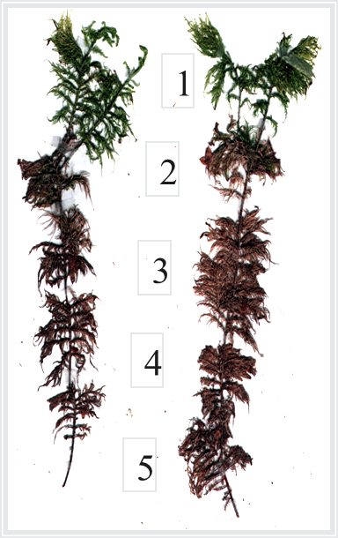
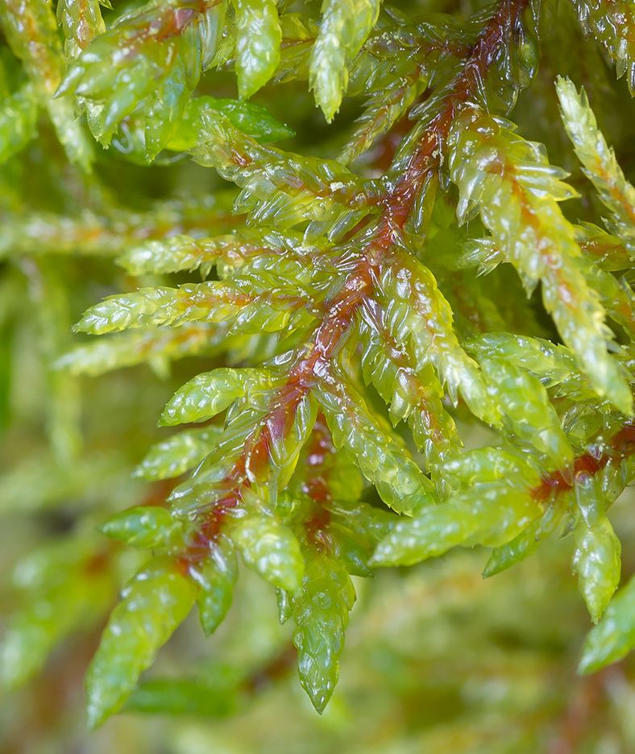
Biomonitoring
Pollution concentration measurement using mosses
Hylocamium splendens
Pleurosium shreberi

Slide 10


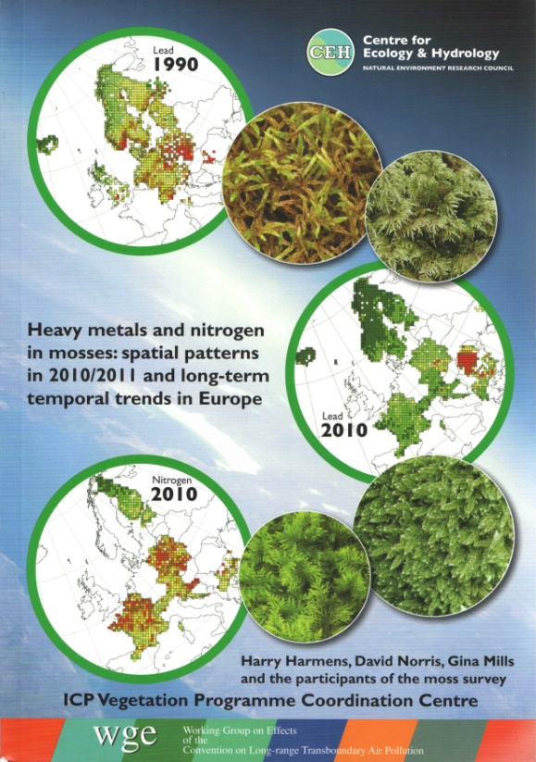
UNECE
CONVENTION ON
LONG-RANGE TRANSBOUNDARY
AIR POLLUTION
adopted in 1979
entered into force 1983
United Nations Economic Commission for Europe
International Cooperative Programme on Effects of Air Pollution on Natural Vegetation and Crops
Working Group on Effects - 1981

Slide 11
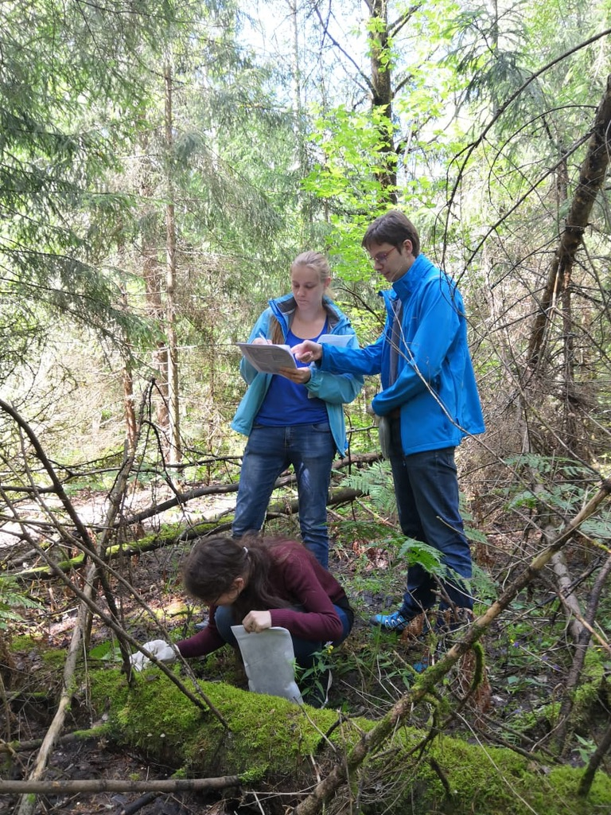
Moss Collecting

Slide 13
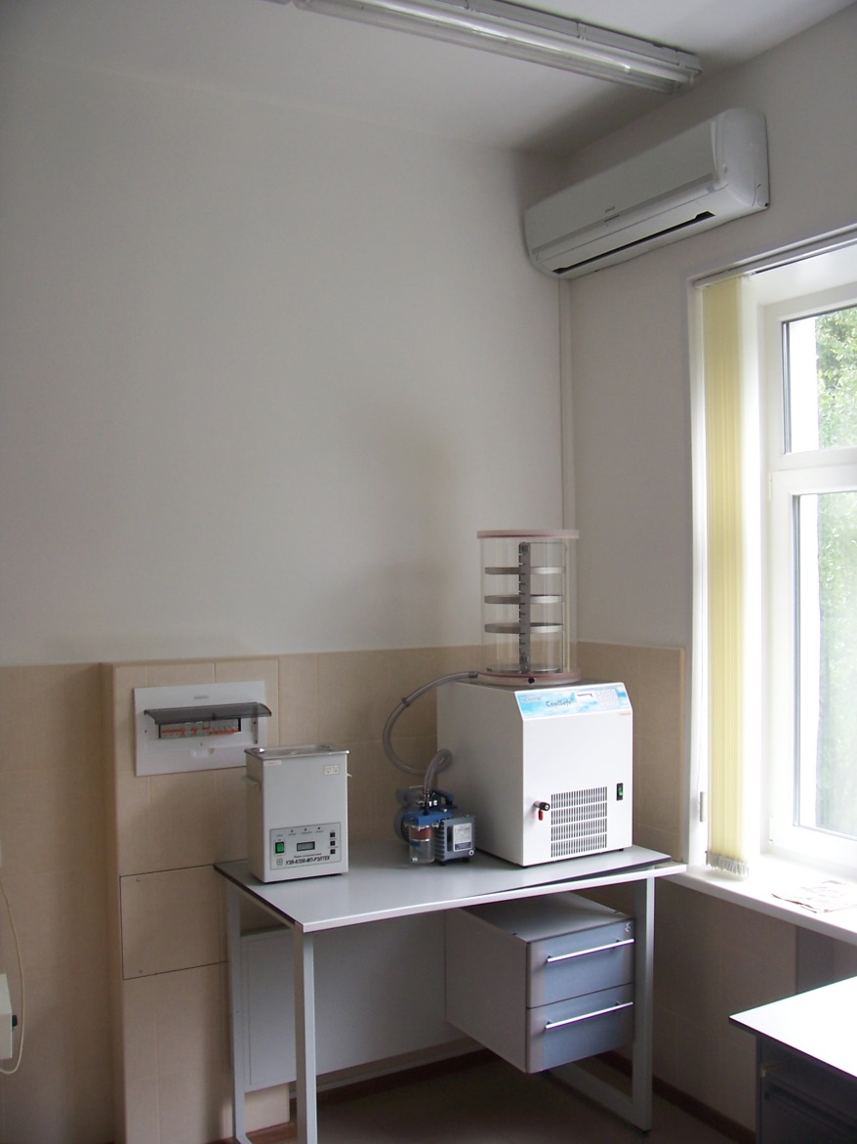
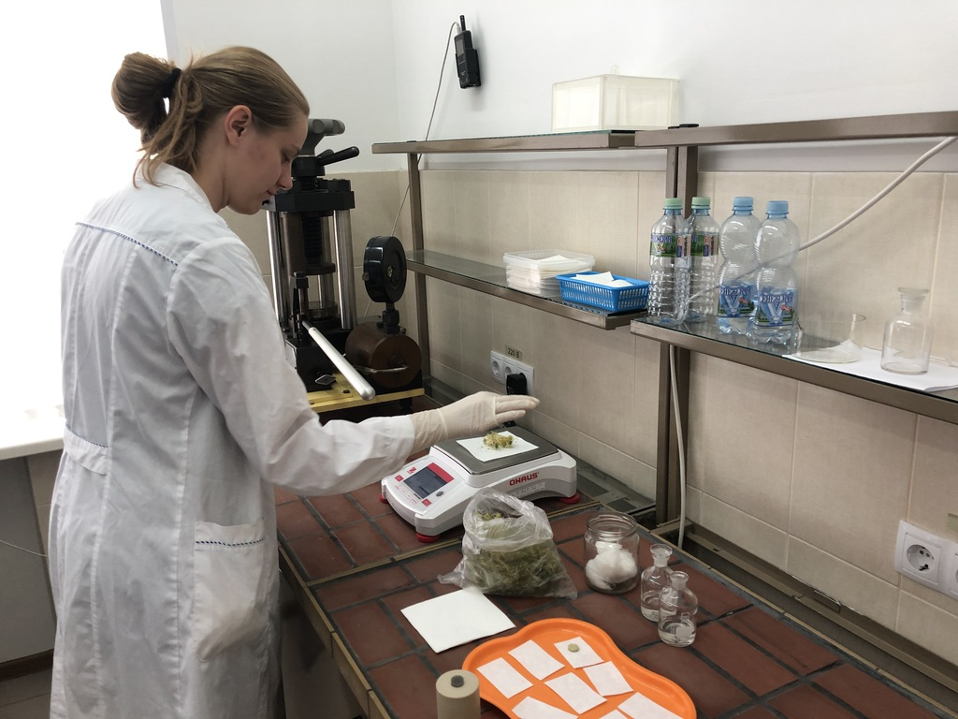
Samples preparation

Slide 14
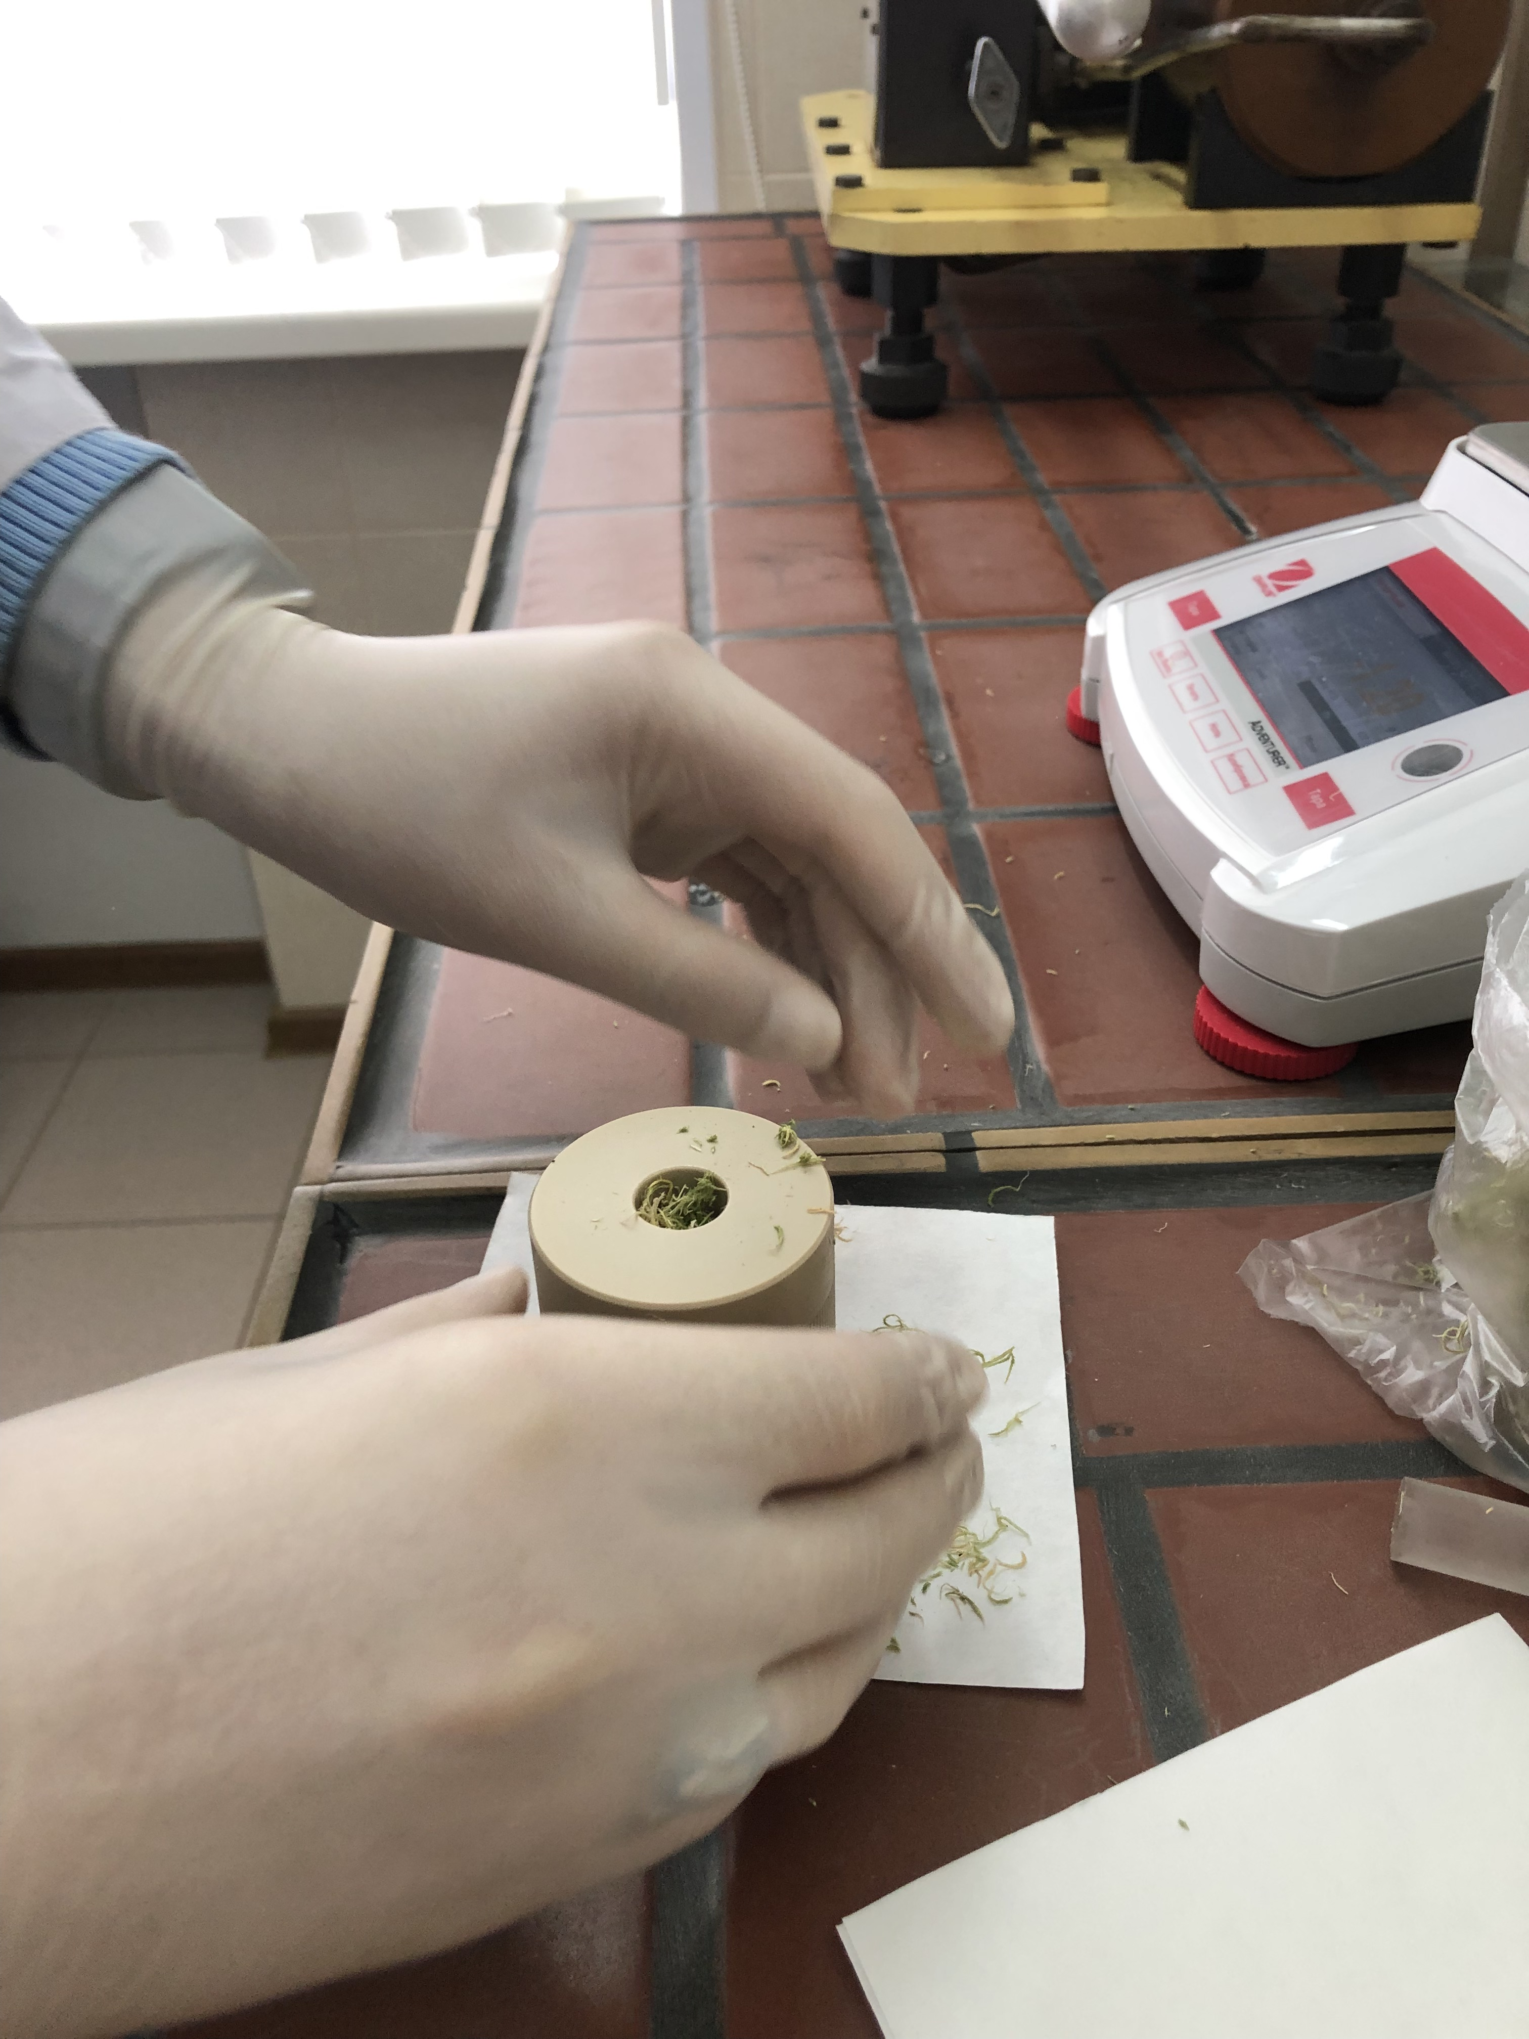
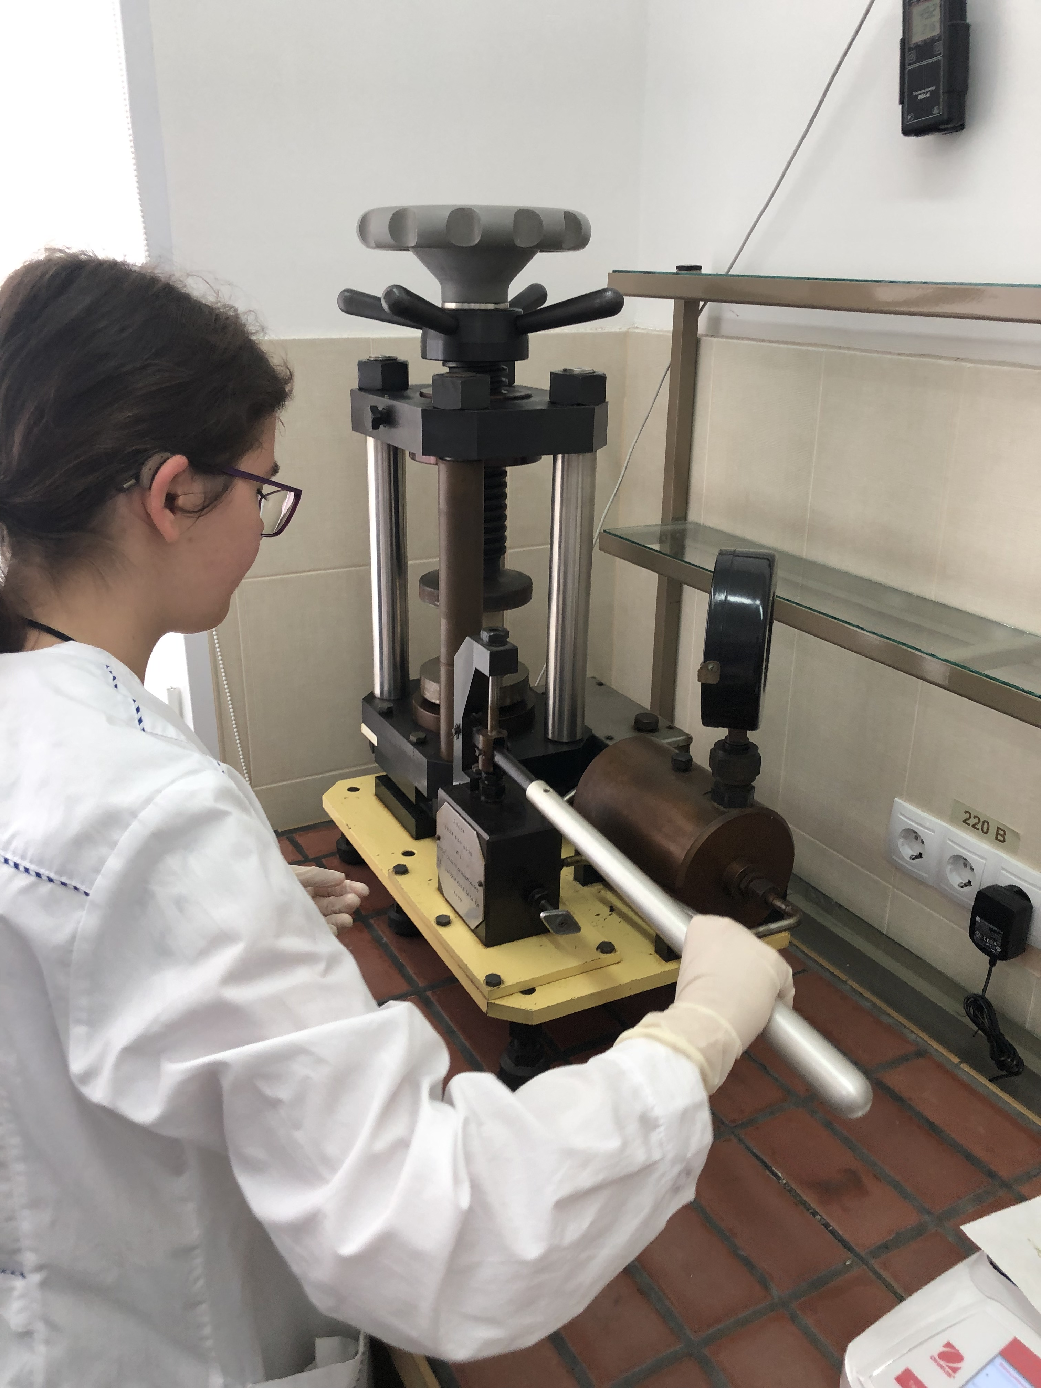

Slide 15
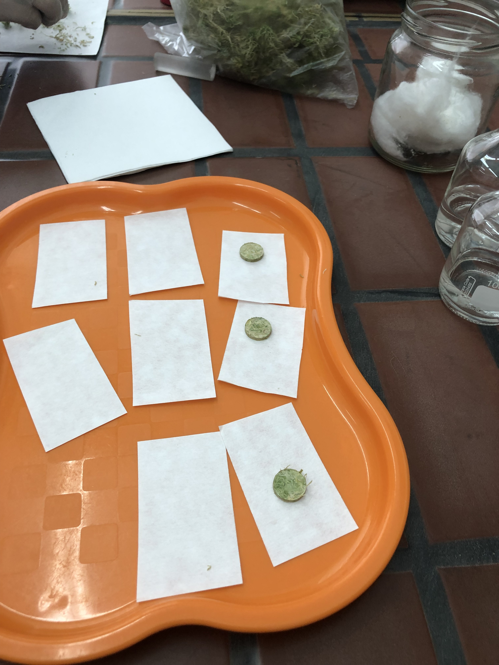
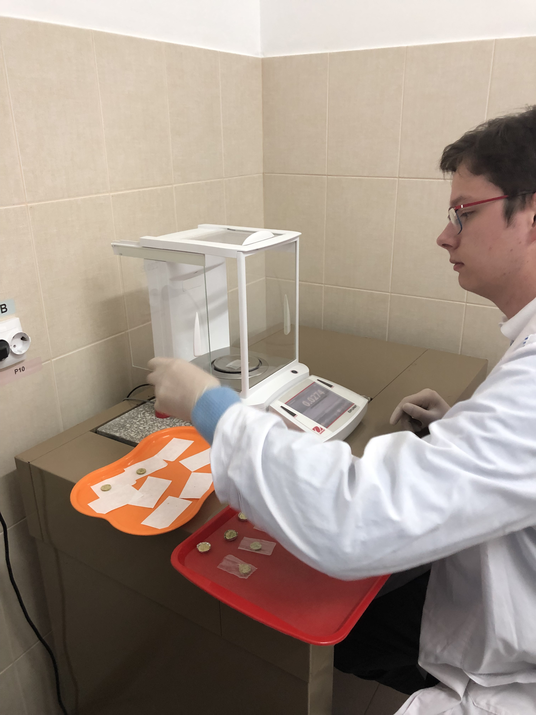

Slide 16
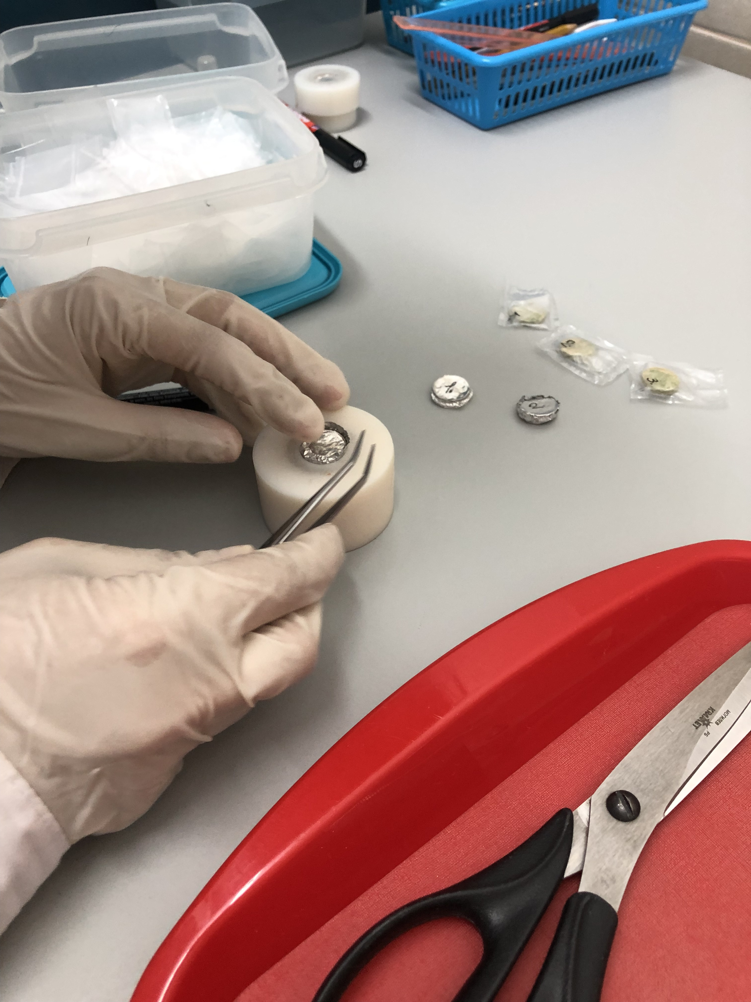
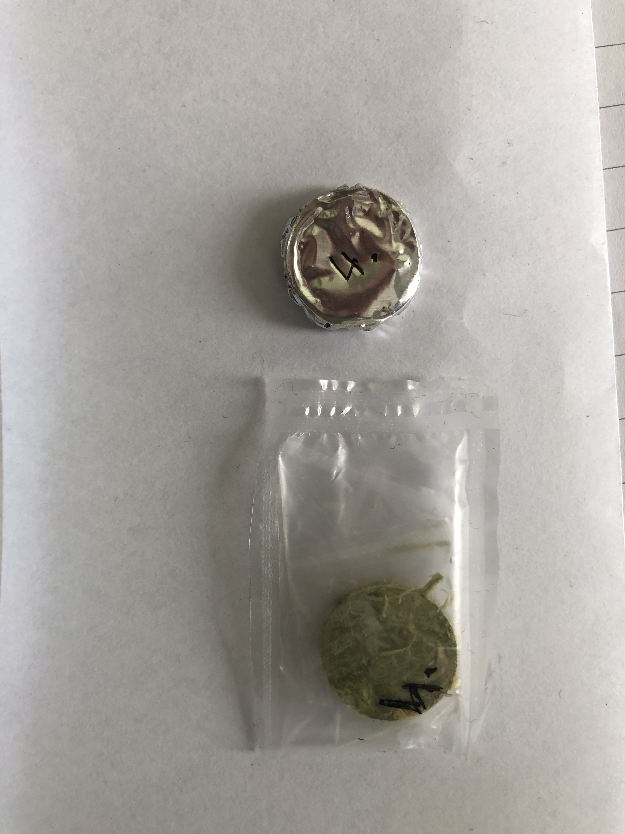

Slide 17
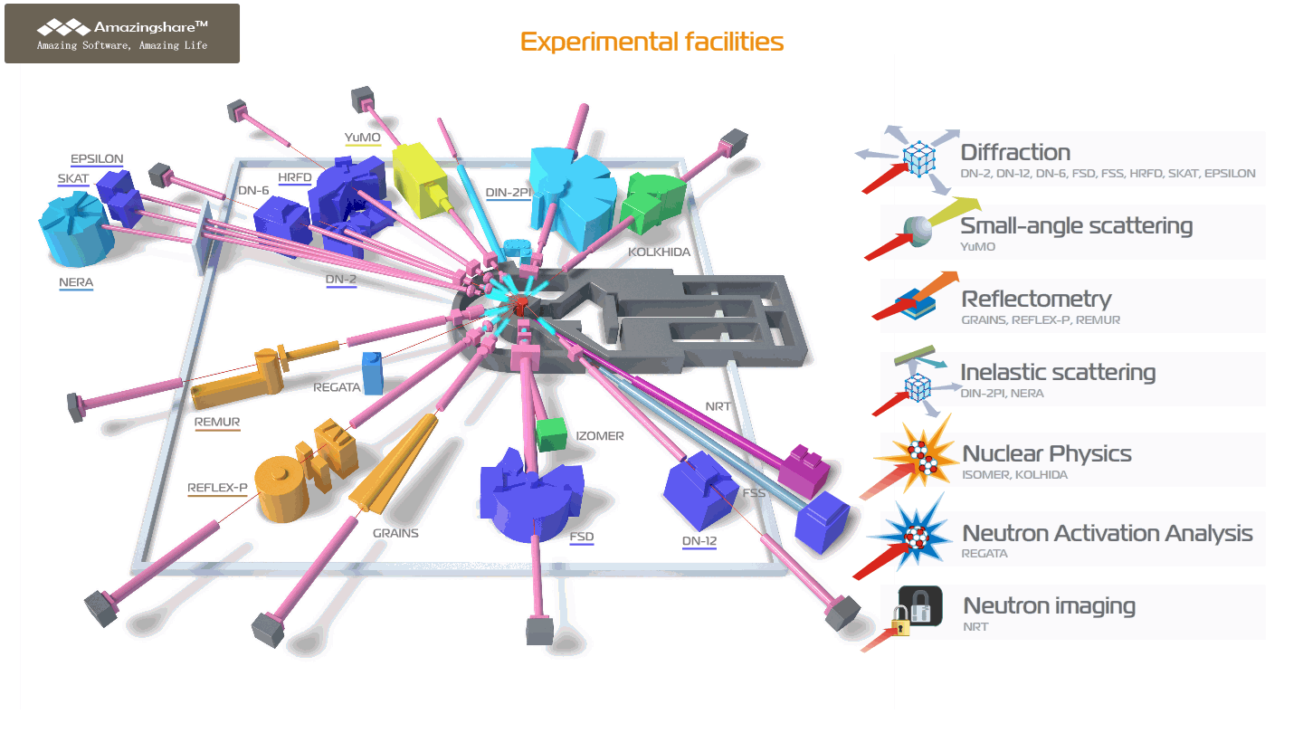
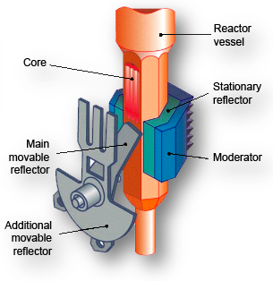
Irradiation
IBR-2M Reactor
  PuO₂
  Fast pulsed
  Na cooled
  Average power 2 MW
  Power in pulse 1850MW
Short lived 1 - 15min
Long lived 3 - 5days usually 3-4days

Slide 18
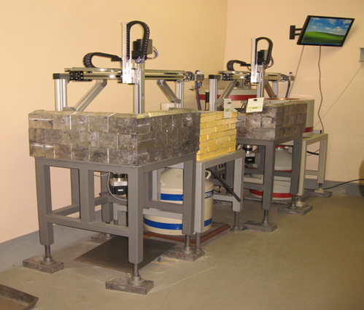
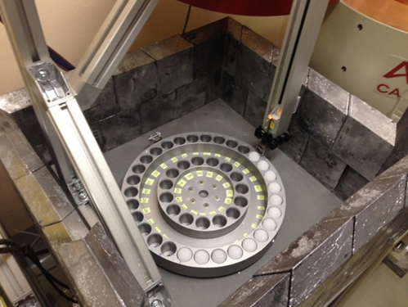
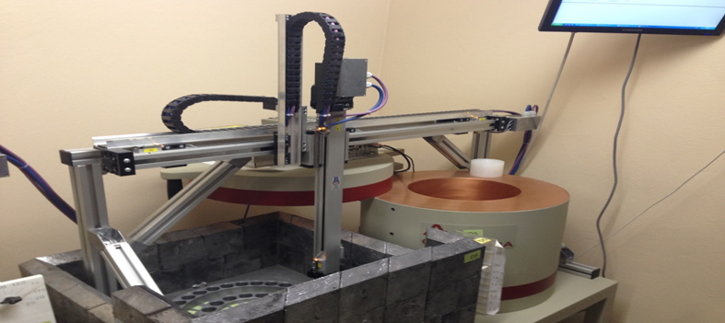
Detection
CANBERRA
HPGe Detector
Short lived
  After 3 min
Long lived
  1st Meas. after 3 days
  2nd Meas. after 21 days
Notes:
HPGe high purity germanium detector

Slide 19

TITLE OF RESEARCH CONTRACT:
Automation of Reactor Neutron Activation Analysis
Part of the IAEA’s Coordinated Research Project (CRP):
Development of an Integrated Approach to Routine
Automation of Neutron Activation Analysis
(Ref. F1.20.25 / CRP1888)

Slide 20
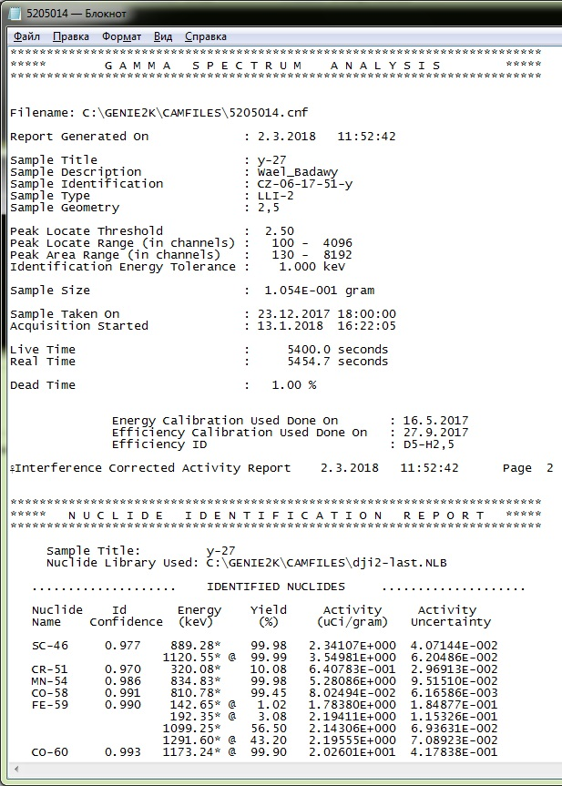
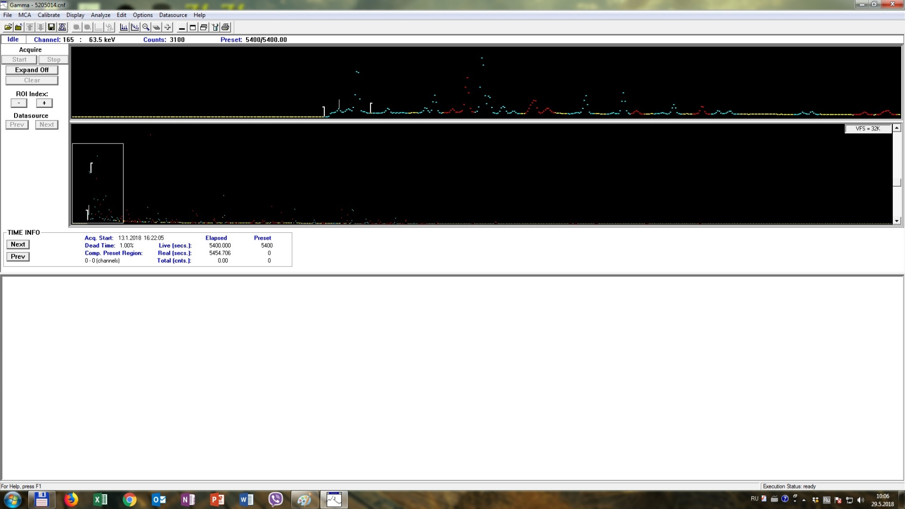
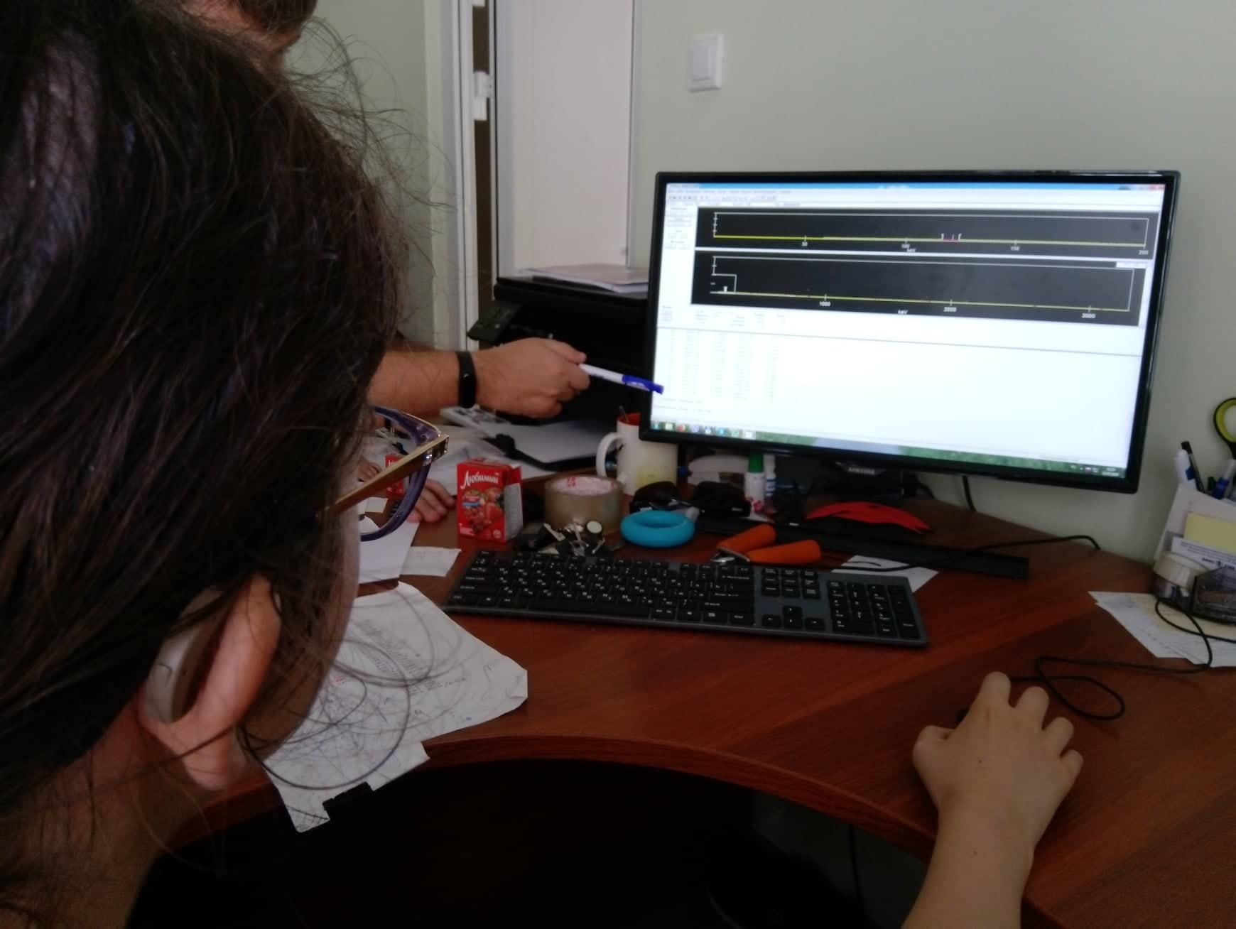
Data Processing
Genie 2000

Slide 21
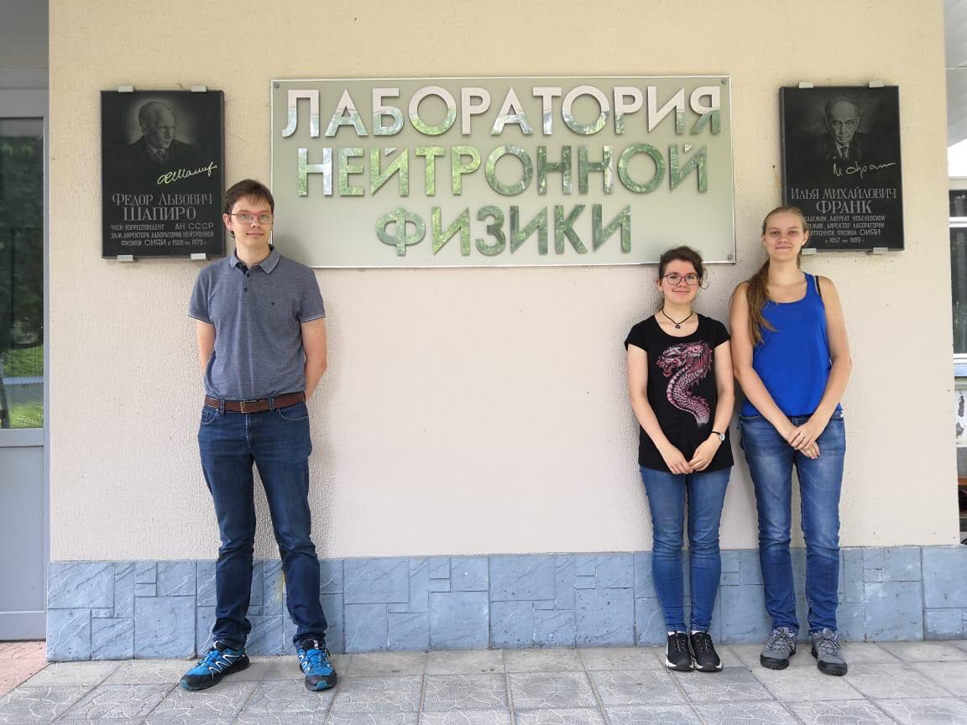
Thank you for your attention

